Slide 1
Cookies
Notes:
Cookies

Slide 2
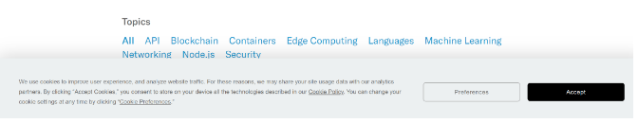
What are cookies?
A cookie is usually a tiny text file stored in your web browser.
A cookie was initially used to store information about the websites that you visit.
But with the advances in technology, a cookie can track your web activities and retrieve your content preferences.
I am sure, at some point, you have seen a pop-up screen similar to the one shown below.

Slide 3
What are cookies?
Cookies save your language preferences. This way, when you visit that website in the future, the language you used will be remembered.
You have most likely visited an e-commerce website. When you include items into your shopping cart, a cookie will remember your choices. Your shopping list item will still be there whenever you revisit the site. Basically, a cookie is used to remember data from the user.
Therefore, cookies are small strings that contain key-value pairs of information sent from the webserver to the browser to get information about the user.

Slide 4
Different types of cookies
Session cookies - store user’s information for a short period. When the current session ends, that session cookie is deleted from the user’s computer.
Persistent cookies - a persistent cookie lacks expiration date. It is saved as long as the webserver administrator sets it.
Secure cookies - are used by encrypted websites to offer protection from any possible threats from a hacker.
Third-party cookies - are used by websites that show ads on their pages or track website traffic. They grant access to external parties to decide the types of ads to show depending on the user’s previous preferences.

Slide 5

Setting Up Cookie
npm install express cookie-parser
Step 1 - Import the installed packages

Slide 6
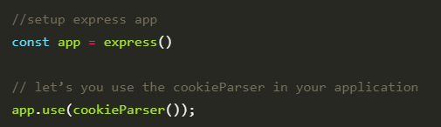
Setting Up Cookie
Step - 2 Get your application to use the packages

Slide 7
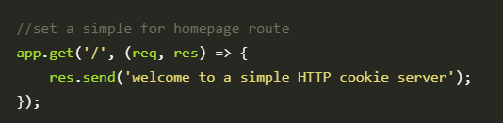

Setting Up Cookie
Step - 3 Set a simple route to start the server

Slide 8
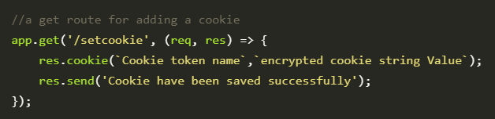
Set a Cookie
We will set a route that will save a cookie in the browser. In this case, the cookies will be coming from the server to the client browser.

Slide 9
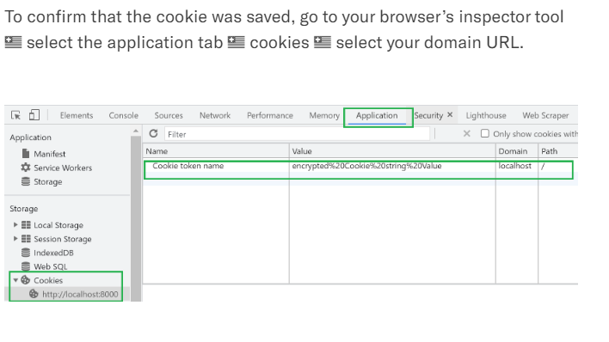
Confirm a Cookie

Slide 10
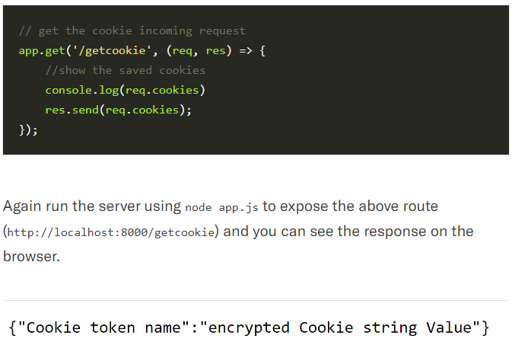
Check a Saved Cookie
Step 2 - Using the req.cookies method to check the saved cookies

Slide 11
Make Cookie Secure
We can add several attributes to make this cookie more secure:
HTTPonly ensures that a cookie is not accessible using the JavaScript code. This is the most crucial form of protection against cross-scripting attacks.
A secure attribute ensures that the browser will reject cookies unless the connection happens over HTTPS.
sameSite attribute improves cookie security and avoids privacy leaks.
By default, sameSite was initially set to none (sameSite = None). This allowed third parties to track users across sites. Currently, it is set to Lax (sameSite = Lax) meaning a cookie is only set when the domain in the URL of the browser matches the domain of the cookie, thus eliminating third party’s domains.
You can also add the maximum time you want a cookie to be available on the user browser. When the set time elapses, the cookie will be automatically deleted from the browser.

Slide 12
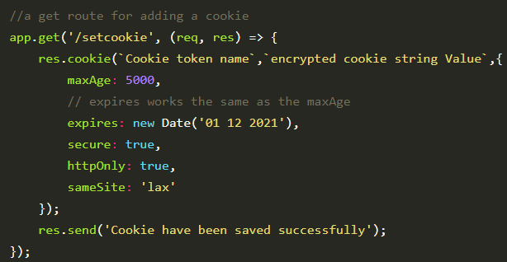
Make Cookie Secure

Slide 13
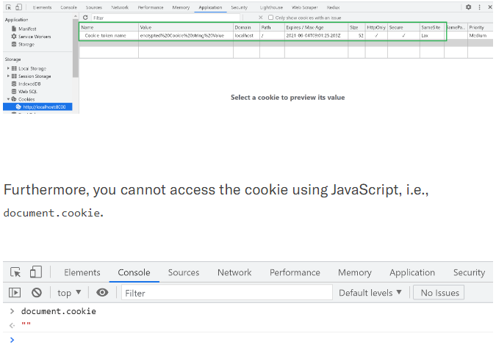
Make Cookie Secure

Slide 14
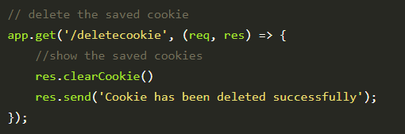
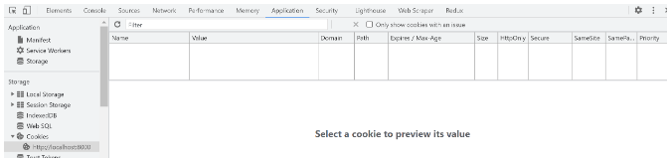
Deleting a cookie

Slide 15
Session Management
A website is based on the HTTP protocol. HTTP is a stateless protocol which means at the end of every request and response cycle, the client and the server forget about each other.
This is where the session comes in. A session will contain some unique data about that client to allow the server to keep track of the user’s state. In session-based authentication, the user’s state is stored in the server’s memory or a database.

Slide 16
Session Management
A website is based on the HTTP protocol. HTTP is a stateless protocol which means at the end of every request and response cycle, the client and the server forget about each other.
This is where the session comes in. A session will contain some unique data about that client to allow the server to keep track of the user’s state. In session-based authentication, the user’s state is stored in the server’s memory or a database.

Slide 17
How sessions works
When the client makes a login request to the server, the server will create a session and store it on the server-side. When the server responds to the client, it sends a cookie. This cookie will contain the session’s unique id stored on the server, which will now be stored on the client. This cookie will be sent on every request to the server.
We use this session ID and look up the session saved in the database or the session store to maintain a one-to-one match between a session and a cookie. This will make HTTP protocol connections stateful.
npm install express-session

Slide 18
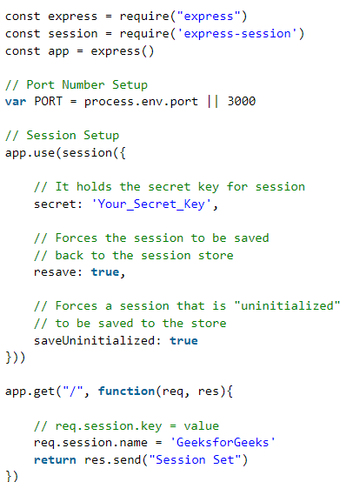
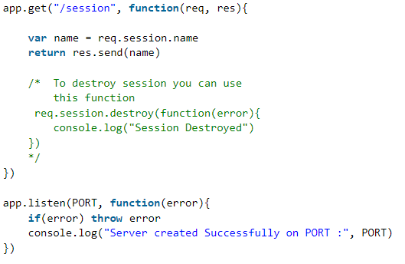
Session Management

Slide 19
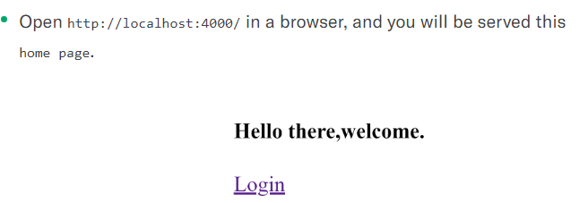
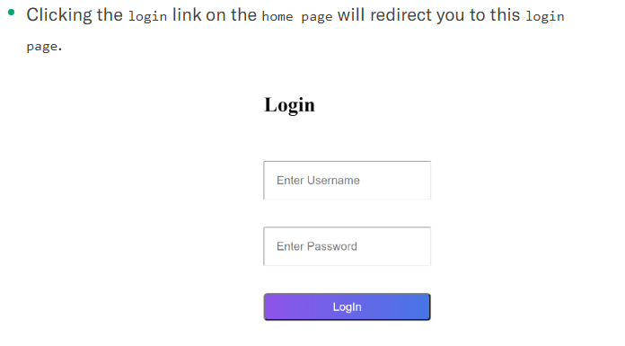
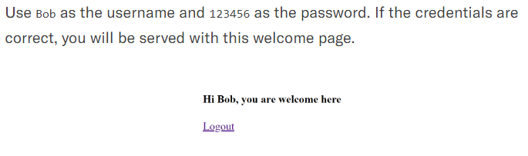
TASK
Let’s have a simple authentication example that uses cookies/sessions to grant access when a user first logs in to a website.

